Slide 1

FIRST 5
Write your summary for your last lesson
What is an outlier?
3. What is the outlier for : 3, 4, 4, 7, 51, 6, 2, 9, 9
4. What type of data can be represented in column graphs?
5. What gets wetter as it dries?

Slide 2
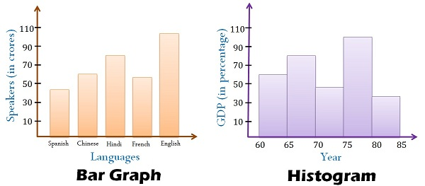
Today’s lesson is about Column graphs.
Gaps
No Gaps
Data is categorical and bars can be swapped around

Slide 3
24
7
30
Histograms
Date
EQ – What steps do I follow to create a histogram?
What is a column graph?
A Column graph shows the frequency of categorical data.
Step 1: Decide on the categories
Step 2: Create table
Step 3: Draw column graph
Notes:
iler

Slide 4
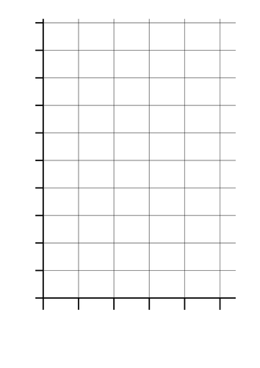
Example: What is your favourite school subject out of Math, English, HASS and Science.
Subject | Tally | Frequency
Math
Science
HASS
English
Notes:
Record data from the class using a hands up survey
Then use the data to draw a column graph on the board using the axis provide (you’re welcome) make sure you include title etc

Slide 5
Activity
We are going to conduct a mini experiment for collecting categorical data
Step 1: Pick a topic or make your own ( it has to be categorical data)
Potential topics:
Favourite brand of shoes
Favourite chocolate in a favourites box
Favourite sports team
Step 2: Draw up a table to collect your data
Step 3: Collect the data from the class
Step 4: Draw a column graph for the data you collected

Slide 6

Sentence Frame- WICOR
AVID
strategy
Summary:
Column graphs display______________________________ data.
To create column graphs we need to decide on appropriate _________________ and then create a ______________ table.
EXIT PASS, completed summary allows you to leave the class.
Notes:
Histograms display continuous numerical data without any gaps. To create histograms we need to decide on appropriate class width sizes and then create a frequency table.

